Slide 1


Detect the flood – an all-in-one flood detection system
Presented by:
Breaking Codes

Slide 2



Why our project?
Multiple Data Sources
A unique approach to tackle floods
Intuitive alerts to user

Slide 3
Modules of the system
Admin Portal
Dam flood preventer
WeatherWiz-
Rainfall predictor
An all-in-one system that provides insights such as Temperature, Precipitation, etc. for the metropolitan cities of India.
Can issue alerts for citizens, where if they fall in the certain radius, they are notified on SMS and WhatsApp messages
Can present detailed Satellite images for the affected areas where they can be downloaded for further detailed image-processing
An IoT-based flood prevention system that checks the water levels of the dam.
if they exceed beyond the threshold, the administration is notified, and the system can take actions by itself on extreme circumstances.
Analyses the rainfall data and predicts if the average rainfall per year can cause flooding or not.
Provides a yet other data source to detect the early occurrence of floods.

Slide 4
Technologies Used
IoT-based Dam flooding prevention system:
Arduino IDE (ESP8266),
ThingSpeak by MathWorks (IoT-cloud detection system)
WeatherWiz:
Python
Pandas, Scikit-learn
Frontend:
React, Bootstrap
Backend:
Node, Express.js, MongoDB.
Image Processing Model:
Python
OpenCV (Computer Vision)
Hosting:
Web app and Backend: Heroku
Database: MongoDB Atlas
Miscellaneous APIs:
MapBox (to retrieve high-res satellite images)
WeatherAPI (to retrieve climatic attributes for cities like temperature, pressure, etc.)
PositionStack (to retrieve coordinates from Keywords)
Twilio (to broadcast WhatsApp and SMS messages)

Slide 5
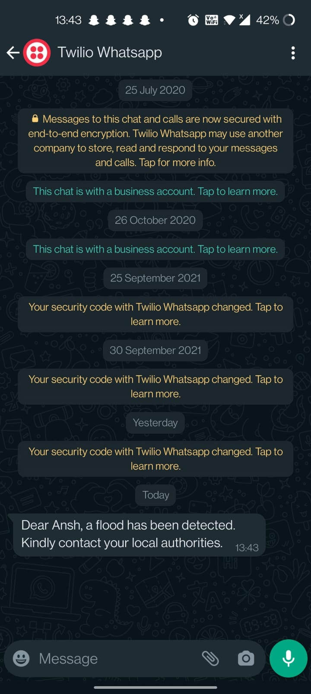
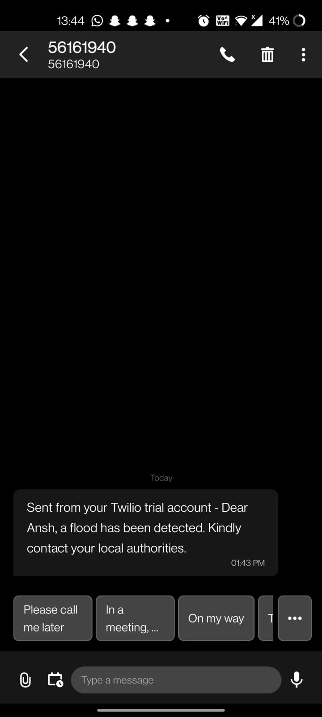
WhatsApp/SMS notification of Alerts

Slide 6
Future Scope
Affected users can be notified with the help of Bluetooth Clustering.
Hydroelectric stations can be deployed where the channels will open in the event of water rising.
Heatwave detection can be performed with the same weather APIs.

Slide 7
Thank you
By Team Breaking Codes

